Slide 1

The Significance Of Continuous User Authentication Of Mobile Devices: Enhancing Security And Privacy
RMPP_PCOM7E | Student # 12687766
Notes:
NOTE:
To change the image on this slide, select the picture and delete it. Then click the Pictures icon in the placeholder to insert your own image.

Slide 2

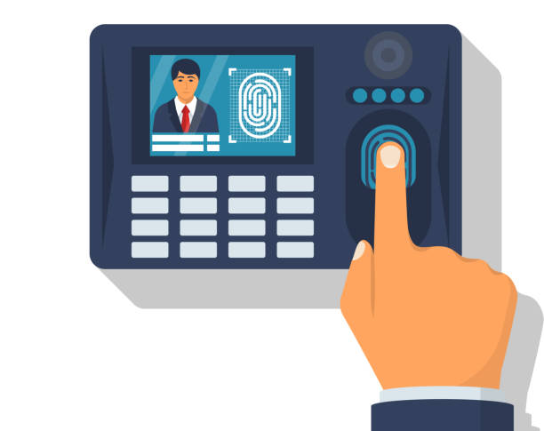
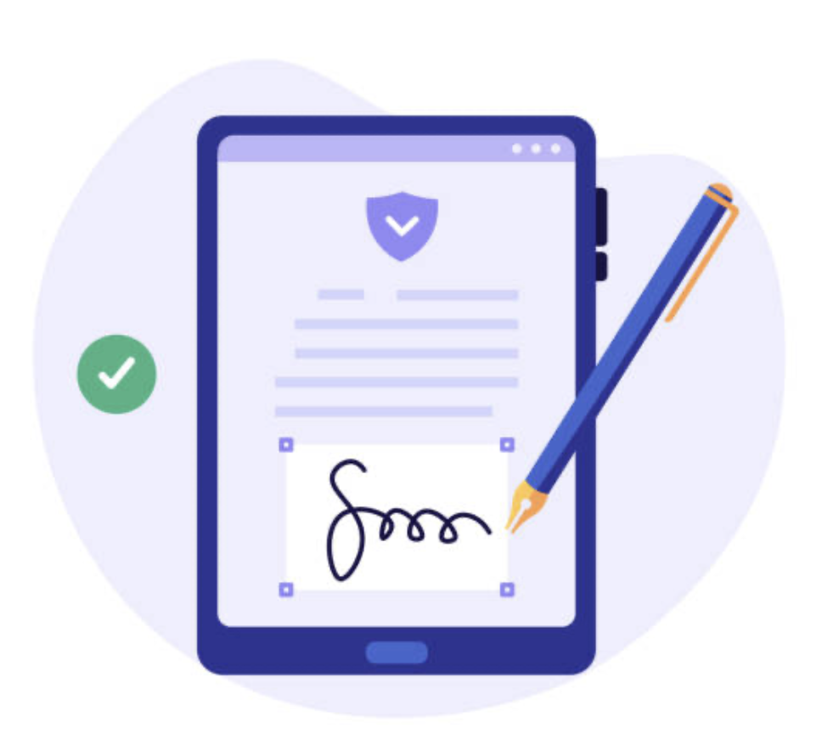

Research Problem
Mobile devices are a part of everyday life
Securing mobile devices with a single layer of security (e.g. PIN) isn’t sufficient
Various added layers to verify identities:
Biometric Authentication
Behavioral Authentication
Location-Based Authentication

Slide 3

Research Questions
How can users' security and privacy be improved by implementing continuous user authentication on mobile devices?
What continuous user authentication techniques improve mobile device security and privacy most?
What are the moral ramifications of continuous user authentication, and how many rules for its proper application are created?
In terms of security and user experience, how effective is continuous user authentication as a mobile device security mechanism, and how does it compare to more conventional authentication methods?

Slide 4





Objectives
Existing Literature
Evaluate Effectiveness
Development and Testing
Developed Model’s Effectiveness

Slide 5
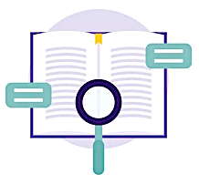
Literature Review
Mobile device security and privacy risks
Traditional authentication measures and their limitations
Continuous user authentication methods and their effectiveness
Mobile device security and privacy regulations and standards
User attitudes and perceptions towards continuous user authentication

Slide 6

Research Methodology
Quantitative data to find and assess trends, patterns, and connections between variables
Online Survey on user attitudes (e.g. Google Forms) and examination using SPSS and Excel programs
Electronic database research (e.g. Google Scholar, Scopus, Web of Science)
Laws and Regulations (e.g. GDPR, PIPEDA)

Slide 7
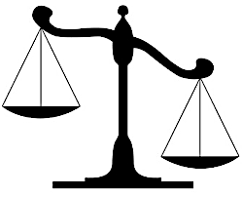
Ethical Considerations & Risk Assessment
Transparency with participants
Participant privacy
Ethics Committee

Slide 8
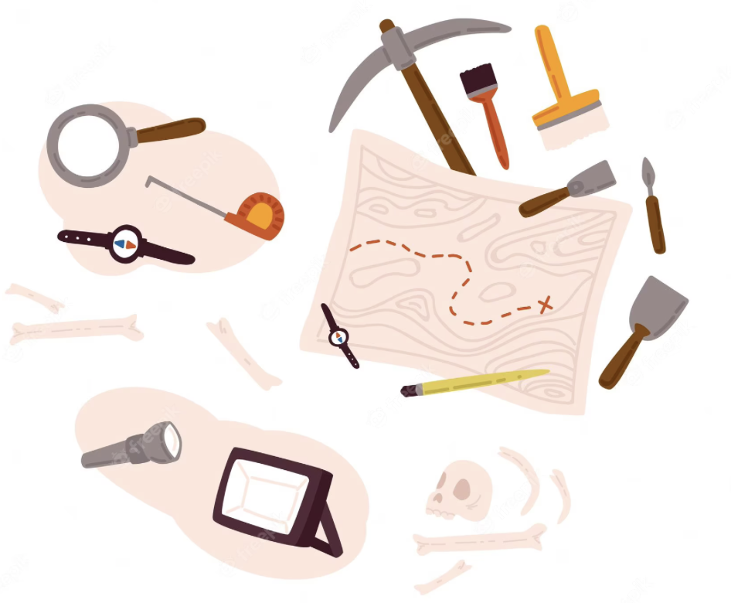
Description of Artifact (s)
Fresh information & new perspective
Security awareness
Aid the industry

Slide 9
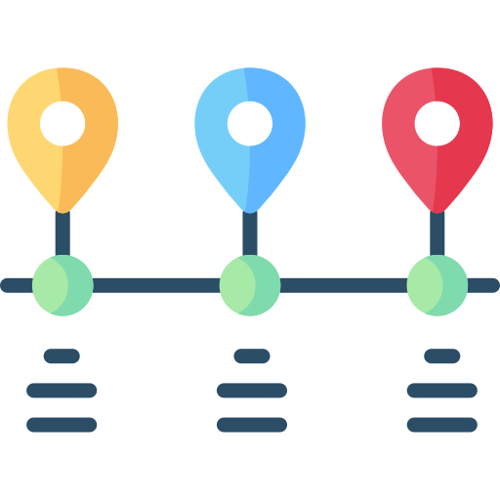
Timeline of Proposed Activities
Literature review: 2 months
Survey: 1 month
Case study: 6 months
Analysis of data: 2 months
Writing up and submission of the research report: 3 months
The timeline may be subject to change depending on unforeseen circumstances.

Slide 10
Appreciate Your Time!
RMPP_PCOM7E | Student # 12687766
Notes:
NOTE:
To change the image on this slide, select the picture and delete it. Then click the Pictures icon in the placeholder to insert your own image.

Slide 11
Reference List
Abomhara, M. and Køien, G.M., 2014, May, ‘Security and privacy in the Internet of Things: Current status and open issues’, In 2014 international conference on privacy and security in mobile systems (PRISMS) (pp. 1-8). IEEE.
Chin, E., Felt, A.P., Sekar, V. and Wagner, D., 2012, July, ‘We are measuring user confidence in smartphone security and privacy’, In Proceedings of the eighth symposium on usable privacy and security (pp. 1-16).
Feng, T., Liu, Z., Kwon, K.A., Shi, W., Carbunar, B., Jiang, Y. and Nguyen, N., 2012, November, ‘Continuous mobile authentication using touchscreen gestures’, In 2012 IEEE conference on technologies for homeland security (HST) (pp. 451-456). IEEE.
Ismagilova, E., Hughes, L., Rana, N.P. and Dwivedi, Y.K., 2020, ‘Security, privacy, and risks within smart cities: Literature review and development of a smart city interaction framework’, Information Systems Frontiers, pp.1-22.
Jose, C.J. and Rajasree, M.S., 2023, ‘Implicit Continuous User Authentication for Mobile Devices Based on Deep Reinforcement Learning’, COMPUTER SYSTEMS SCIENCE AND ENGINEERING, 44(2), pp.1357-1372.
La Polla, M., Martinelli, F. and Sgandurra, D., 2012, ‘A survey on security for mobile devices’, IEEE communications surveys & Tutorials, 15(1), pp.446-471.
Martínez-Pérez, B., De La Torre-Díez, I. and López-Coronado, M., 2015, ‘Privacy and security in mobile health apps: a review and recommendations’, Journal of medical systems, 39, pp.1-8.
Mombeuil, C. and Uhde, H., 2021, ‘Relative convenience, relative advantage, perceived security, perceived privacy, and continuous use intention of China's WeChat Pay: A mixed-method two-phase design study’, Journal of Retailing and Consumer Services, 59, p.102384.
Patel, V.M., Chellappa, R., Chandra, D. and Barbello, B., 2016, ‘Continuous user authentication on mobile devices: Recent progress and remaining challenges’, IEEE Signal Processing Magazine, 33(4), pp.49-61.
Shabtai, A., Fledel, Y., Kanonov, U., Elovici, Y., Dolev, S. and Glezer, C., 2010, ‘Google Android: A comprehensive security assessment’, IEEE Security & Privacy, 8(2), pp.35-44.
Sicari, S., Rizzardi, A., Grieco, L.A. and Coen-Porisini, A., 2015, ‘Security, privacy, and trust in Internet of Things: The road ahead’, Computer networks, 76, pp.146-164.
Skalkos, A., Stylios, I., Karyda, M. and Kokolakis, S., 2021, ‘Users' privacy attitudes towards using behavioral biometrics continuous authentication (BBCA) technologies: A protection motivation theory approach’, Journal of Cybersecurity and Privacy, 1(4), pp.743-766.

